Slide 2
AI/ML for Cybersecurity
UX23CS642A
Prof. Vineetha B
Lecture #

Slide 3
Disclaimer
This presentation is purely educational.
The views expressed by the presenter is not representation of any organization.
The views are based on professional experience of the presenter and no liability is accepted by the presenter in the event of any potential or perceived losses resulting from this presentation.

Slide 5
A Note on Security
In this course, you will be exposed to information about security problems and vulnerabilities with computing systems and networks.
To be clear, you are not to use this or any other similar information to test the security of, break into, compromise, or otherwise attack, any system or network without the express consent of the owner.
In particular, you will comply with all my instructions when doing the labs.
My instructions are in consonance with applicable laws of India and PES University policies.
If in any doubt, please consult your professor!
Any violation is at YOUR RISK! And may result in severe consequences.

Slide 6
GANs - Hands On
Mal-GAN

Slide 7
What are Mal-GANs?
Mal-GANs are based on the traditional Generative Adversarial Networks (GAN) to generate adversarial malware examples, which are able to bypass black-box machine learning based detection models.
The synthetic malware examples or samples generated by Mal-GANs can be used for training the machine learning based detection models to enhance the robustness and the performance of the same.
Mal-GAN comprises of a generator, black box and a substitute detector.
The generator model is a multi-layer feed-forward neural network that transforms the feature vector into its adversarial version. It takes the concatenation of a malware feature vector m and a noise vector z as the input.
The black box is an external system which adopts machine learning based malware detection algorithms. The generator and the substitute detector work together to attack a machine learning based black-box malware detector. The black box model is trained independently before

Slide 8
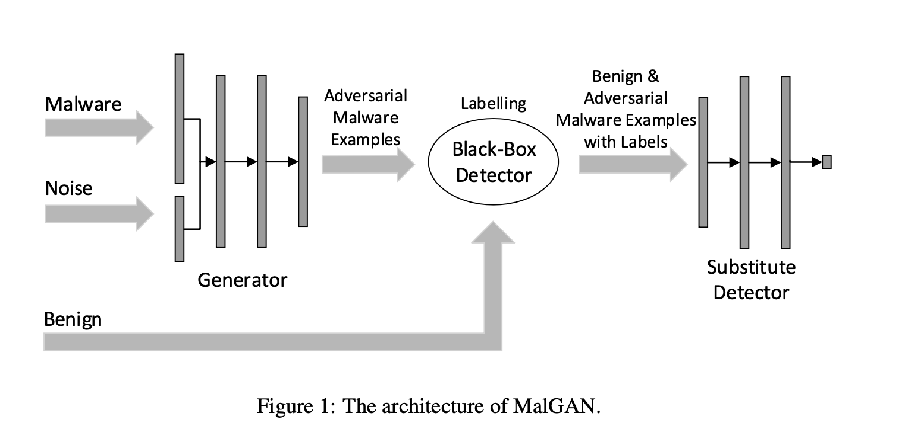
What are Mal-GANs?
and after the generator and substitute detectors are trained adversarially. This allows for a distinct and specialised analysis of the system’s behaviour.
The substitute detector is a multi-layer feed-forward neural network which takes a program feature vector as input. It classifies the program between benign program and malware. The goal of the substitute detector is to fit the black box detector.

Slide 9
Hands On
Code implementation of Mal-GAN has been delineated in the following slides.
The Mal-GAN model was built over the dataset provided at the link : https://www.kaggle.com/datasets/amauricio/pe-files-malwares using Tensorflow framework.
The dataset contains features related to Portable Executable files. Portable Executable (PE) files are a file format used in the Windows operating system to store executable code, data, and resources for running programs. They are the standard executable file format for 32-bit and 64-bit versions of Windows, replacing the older 16-bit New Executable (NE) format used in earlier versions of Windows.
In the context of PE files, ‘benign’ and ‘malware’ refer to two different types of software programs.
Benign Data : Benign data in the context of PE files refers to legitimate and safe executable files. These are software applications, programs, or system files that have been digitally signed by reputable publishers or are known to be developed by trustworthy sources. Benign PE files are intended to perform specific functions or tasks without causing harm to the computer system or the user's data. Examples of benign PE files include applications like Microsoft Office, web browsers, media players, and various system utilities.

Slide 10
Hands On
Malware Data : Malware (short for malicious software) data in the context of PE files refers to executable files that are designed to carry out harmful or unauthorised activities on a computer system. Malware can take many forms, such as viruses, worms, trojan horses, ransomware, spyware, and adware. These malicious programs are typically created with the intention of stealing sensitive information, damaging the system, or gaining unauthorised access to the user's computer.
This hands on will feature building a malware detection system for classifying PE files as either benign or malware based on file related features available. Later, the hands on will involve attacking the malware detection system using the synthetic malware samples generated by the Mal-GAN.

Slide 11
Hands On
The first step will involve data preprocessing.
The second step will involve building and training the malware detection system on the preprocess data.
The third step will feature building and training Mal-GAN for generating synthetic that can evade the detection system.
The fourth step will involve attacking the malware detection system using the synthetic samples produced by Mal-GAN

Slide 12
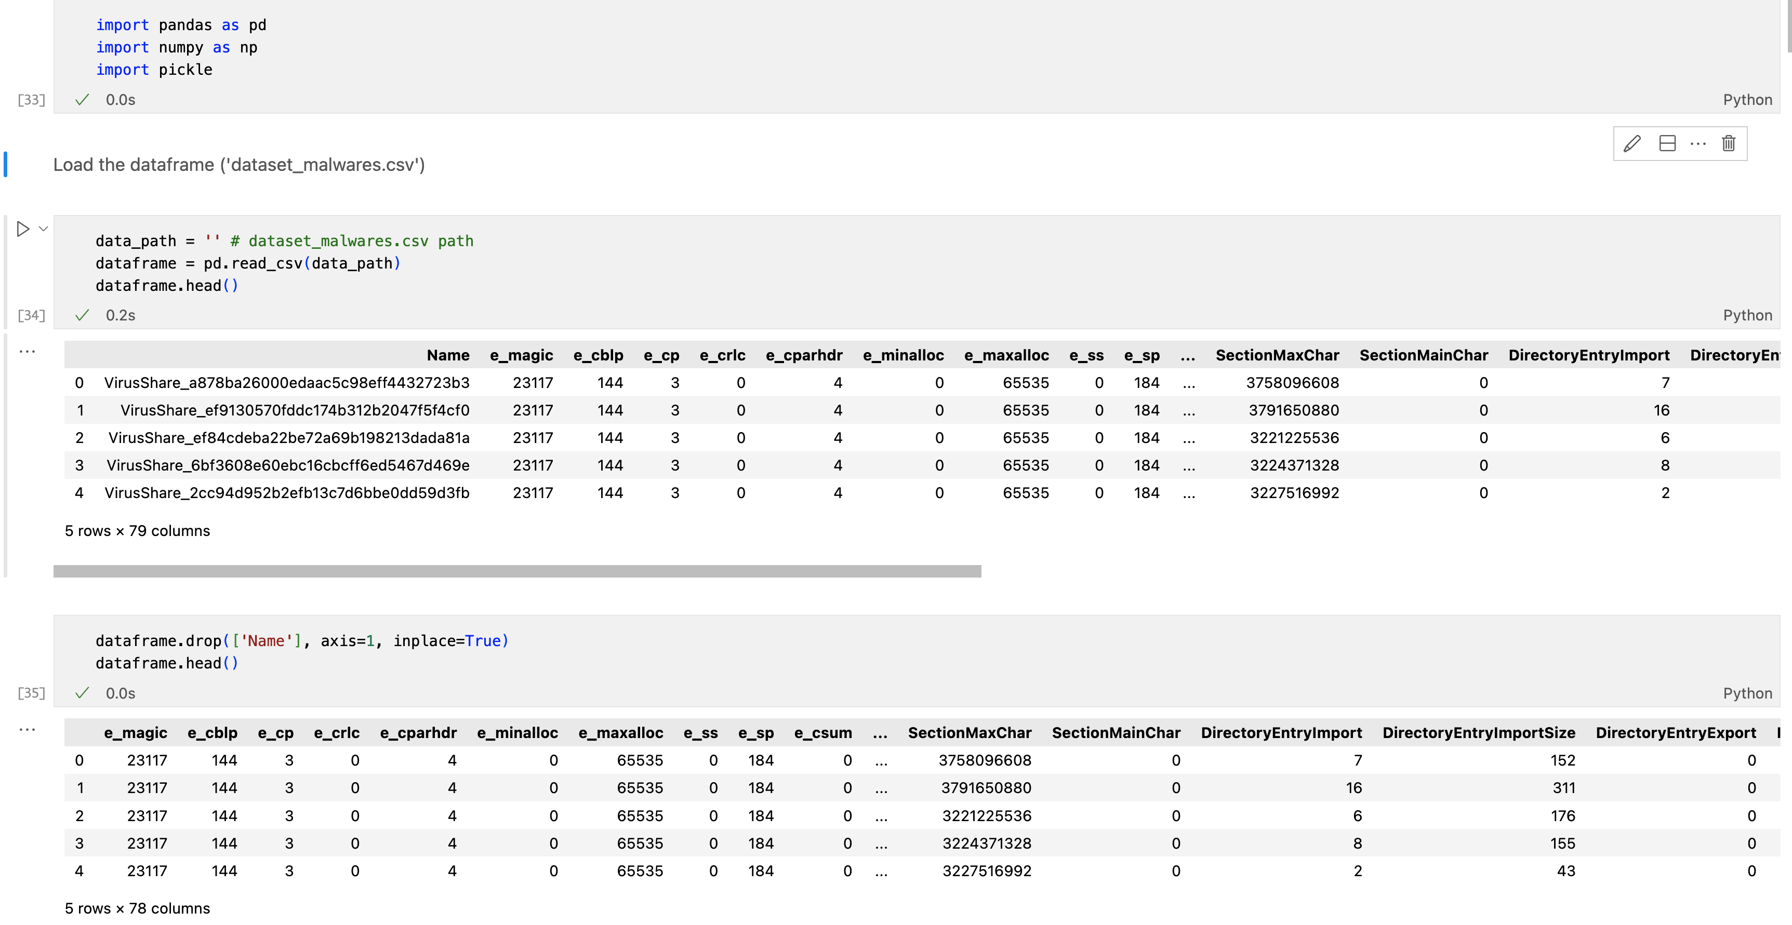
Step - 1 : Data Preprocessing

Slide 13
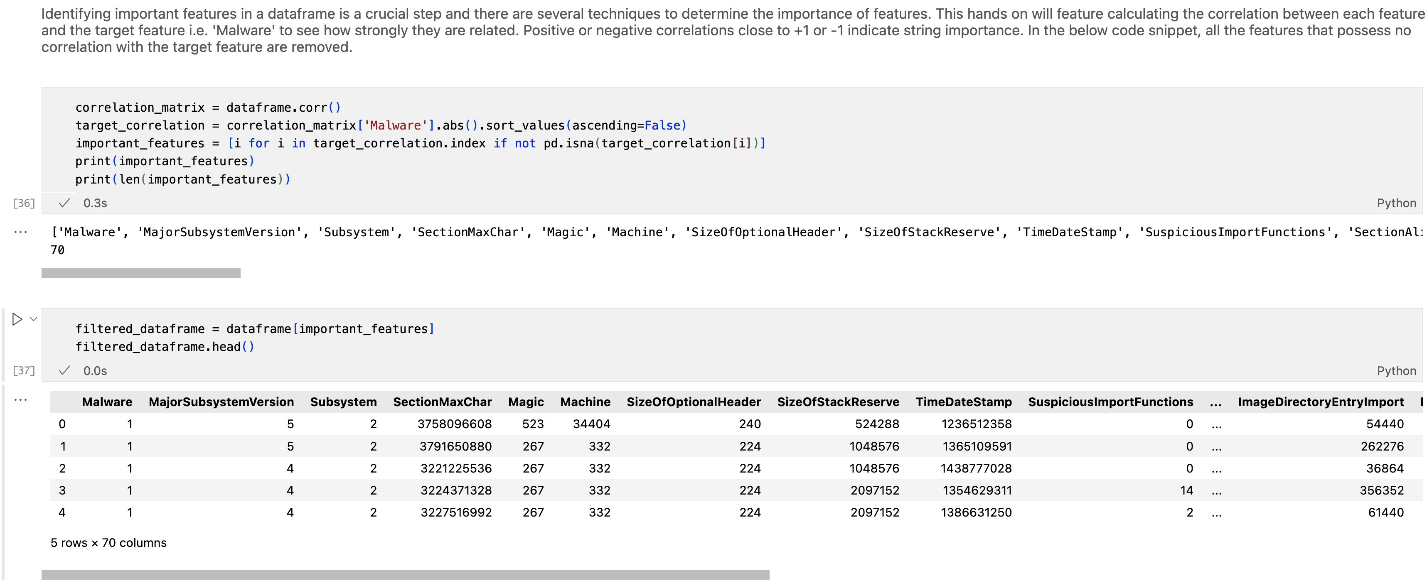
Step - 1 : Data Preprocessing

Slide 14
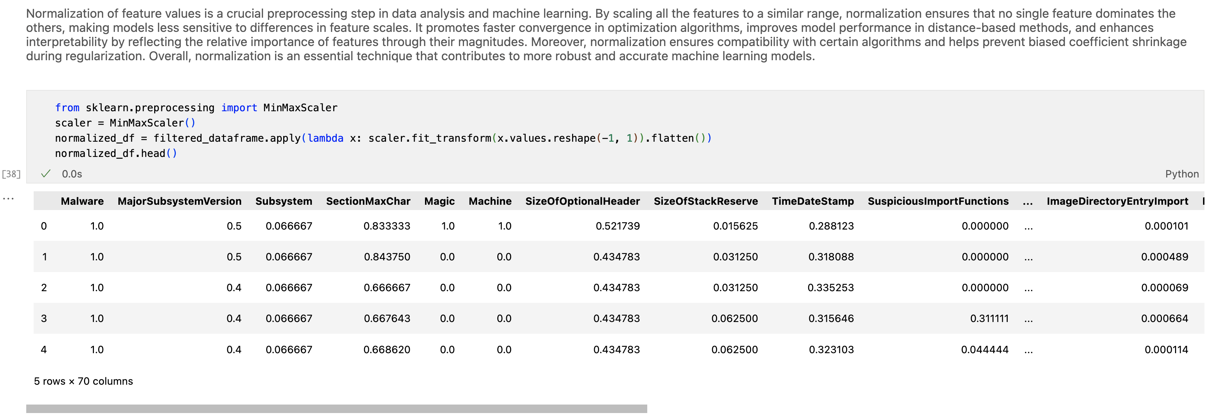
Step - 1 : Data Preprocessing

Slide 15
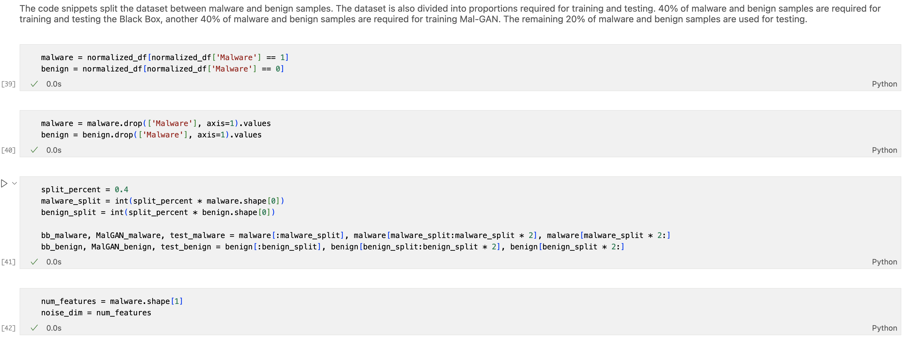
Step - 1 : Data Preprocessing

Slide 16
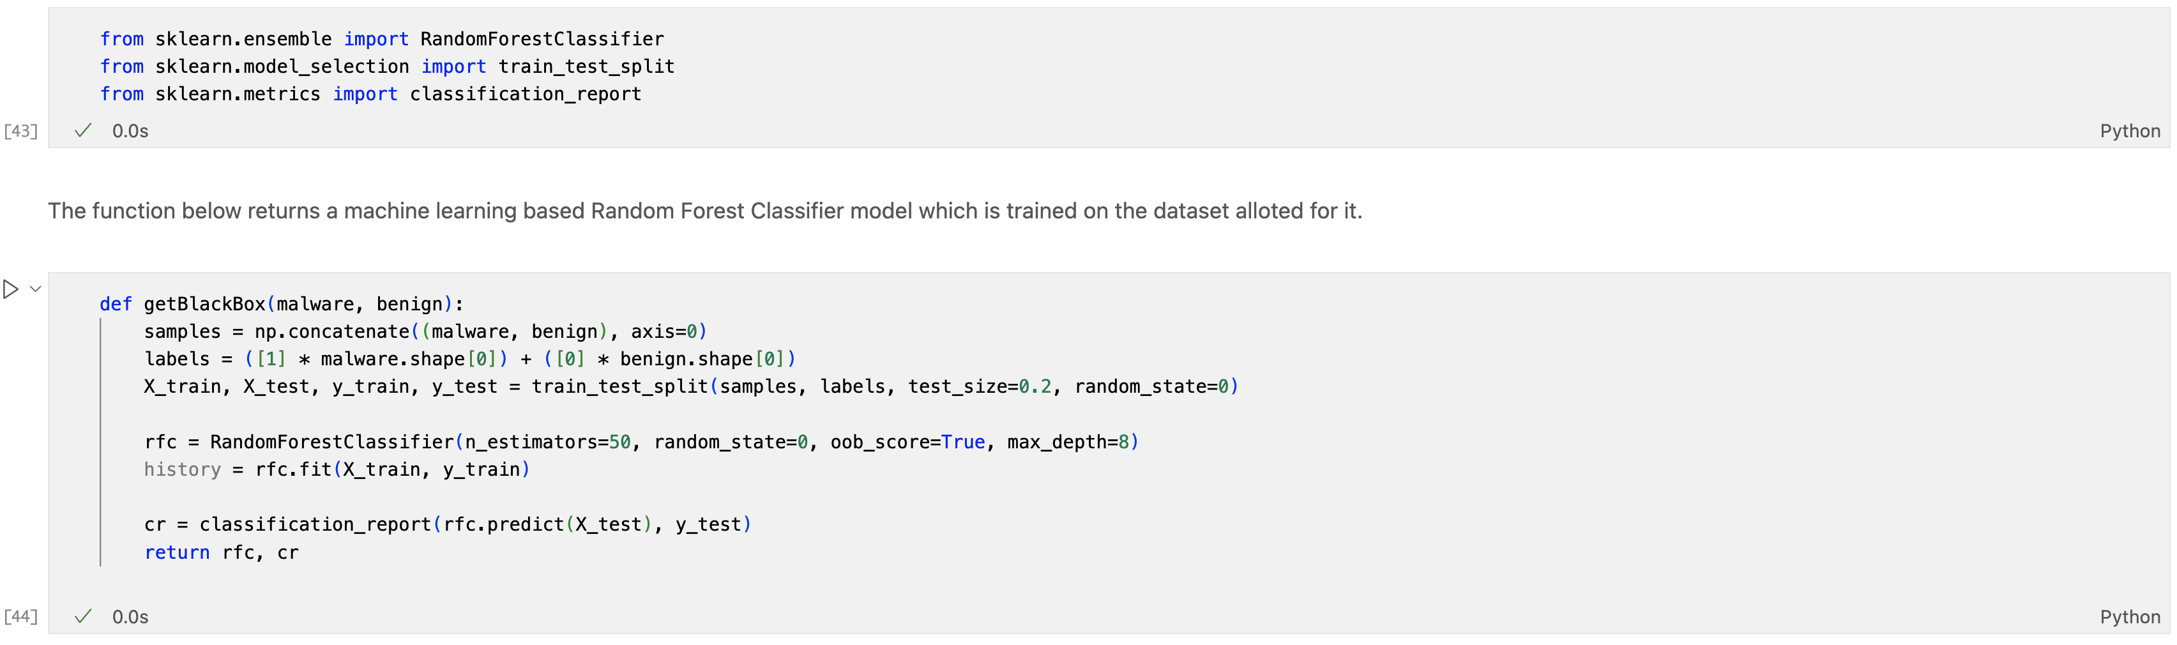
Step - 2: Building and training Malware Detection System

Slide 17
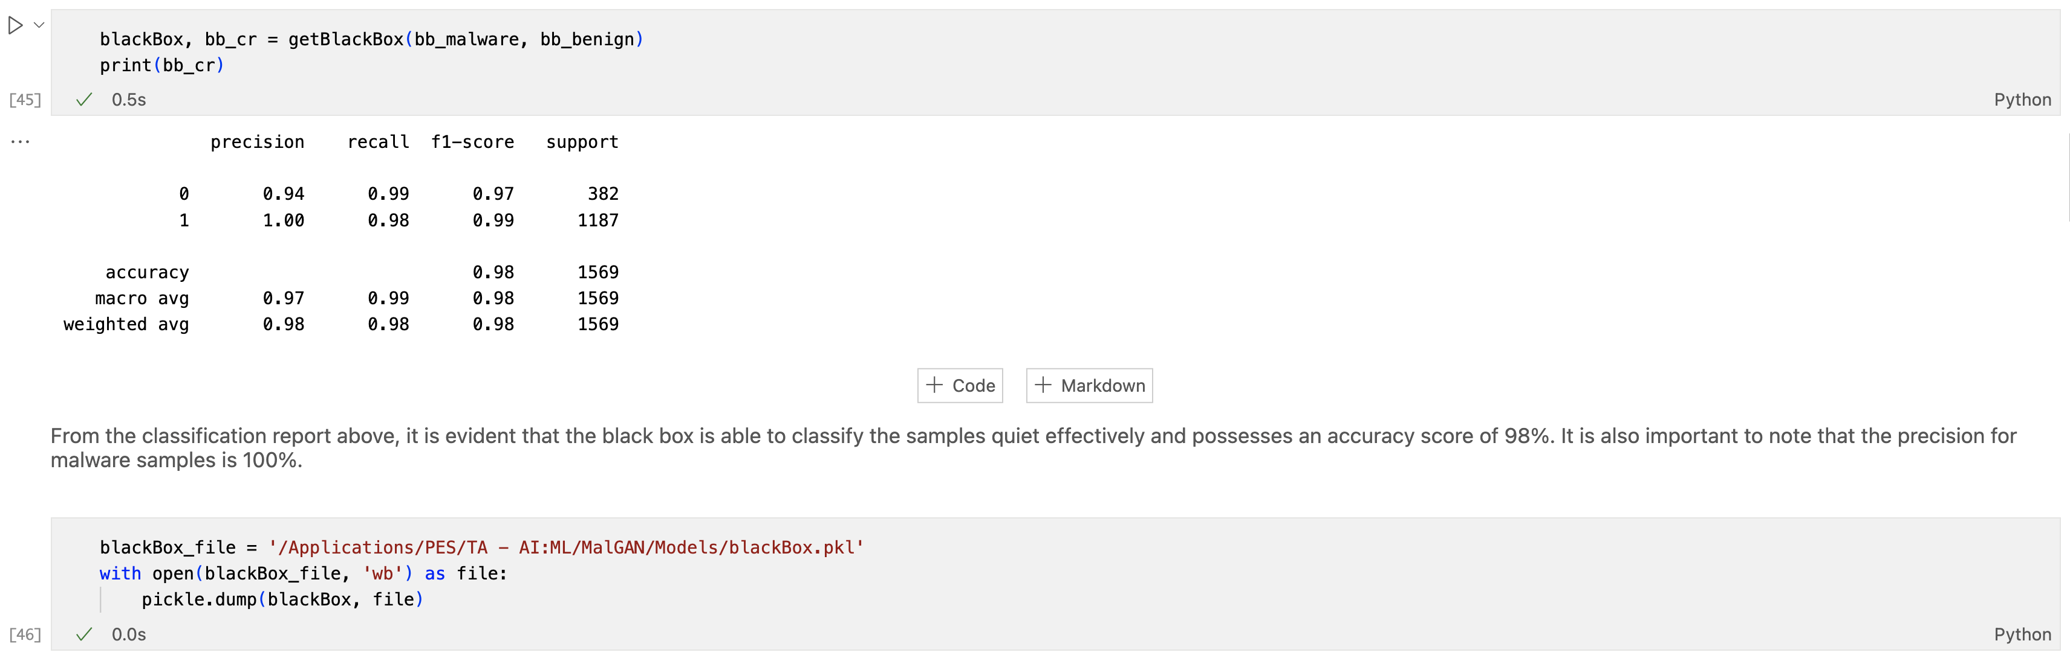
Step - 2: Building and training Malware Detection System

Slide 18
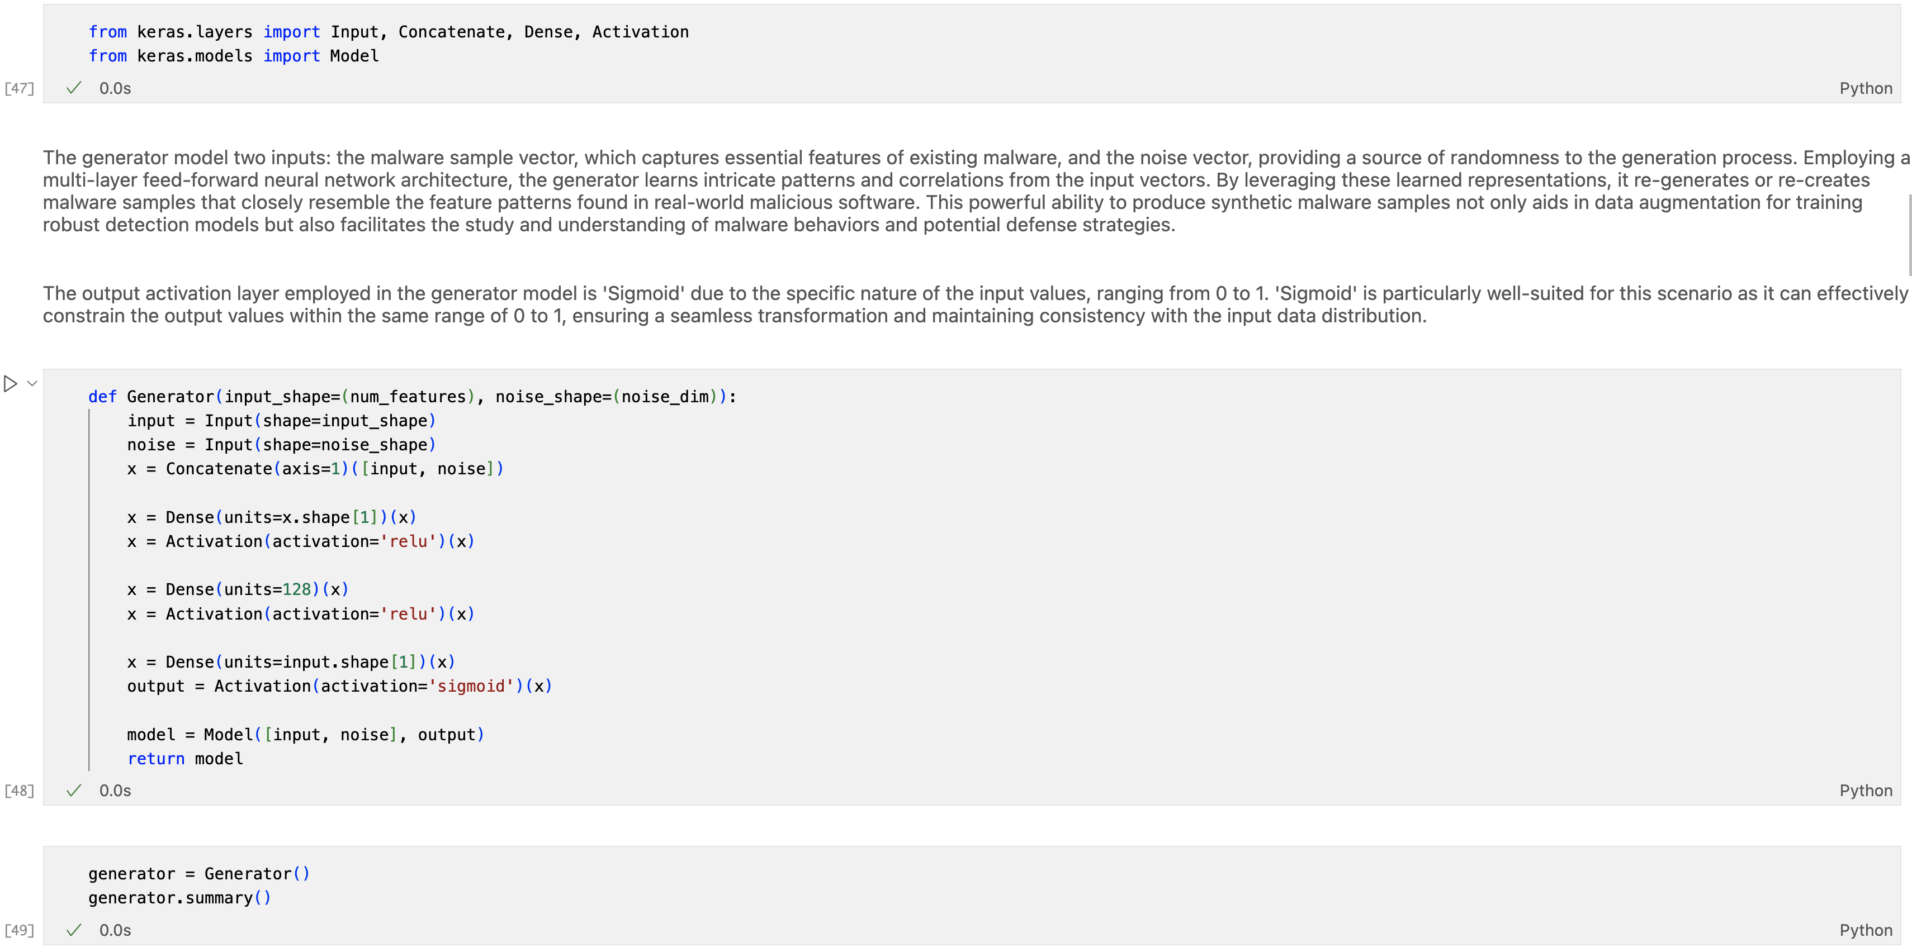
Step - 3: Building and training Mal-GAN

Slide 19
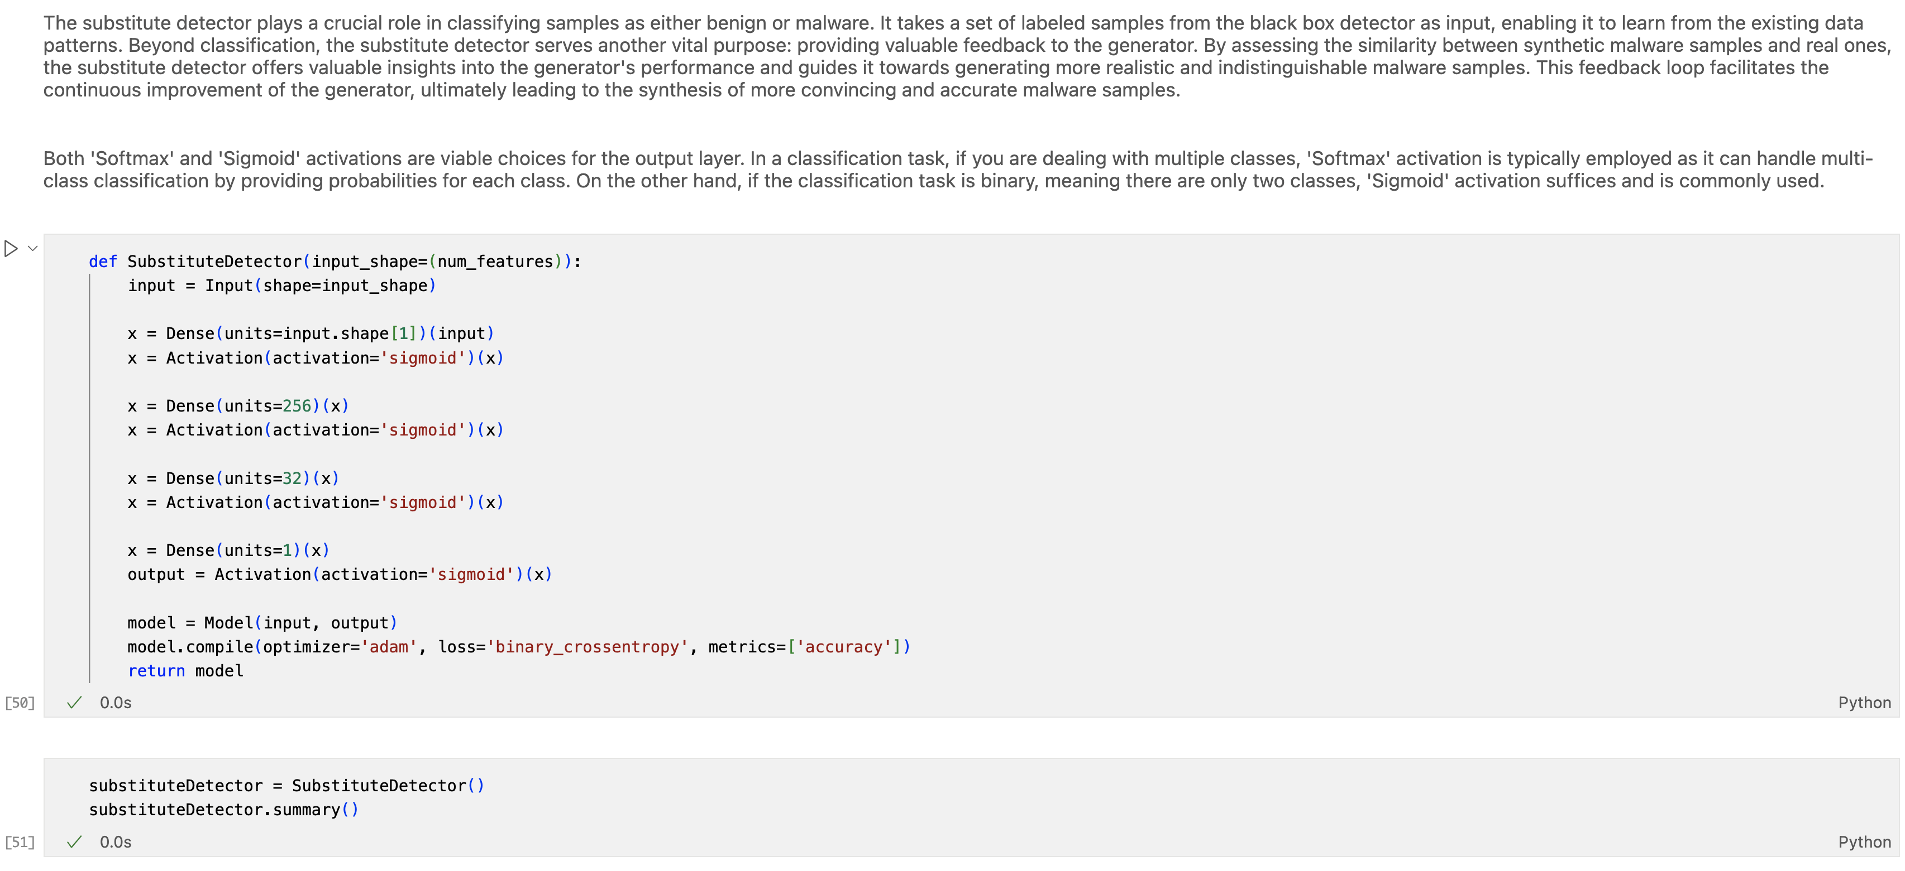
Step - 3: Building and training Mal-GAN

Slide 20
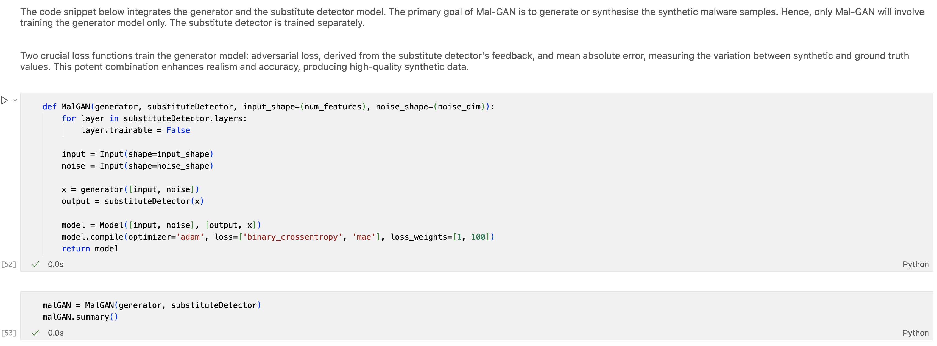
Step - 3: Building and training Mal-GAN

Slide 21
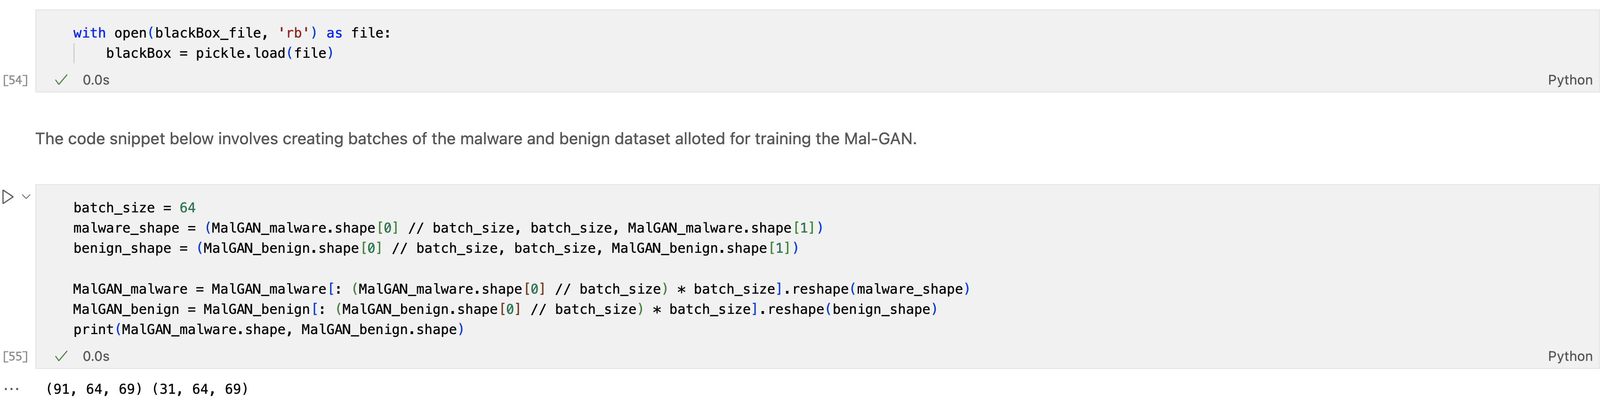
Step - 3: Building and training Mal-GAN

Slide 22
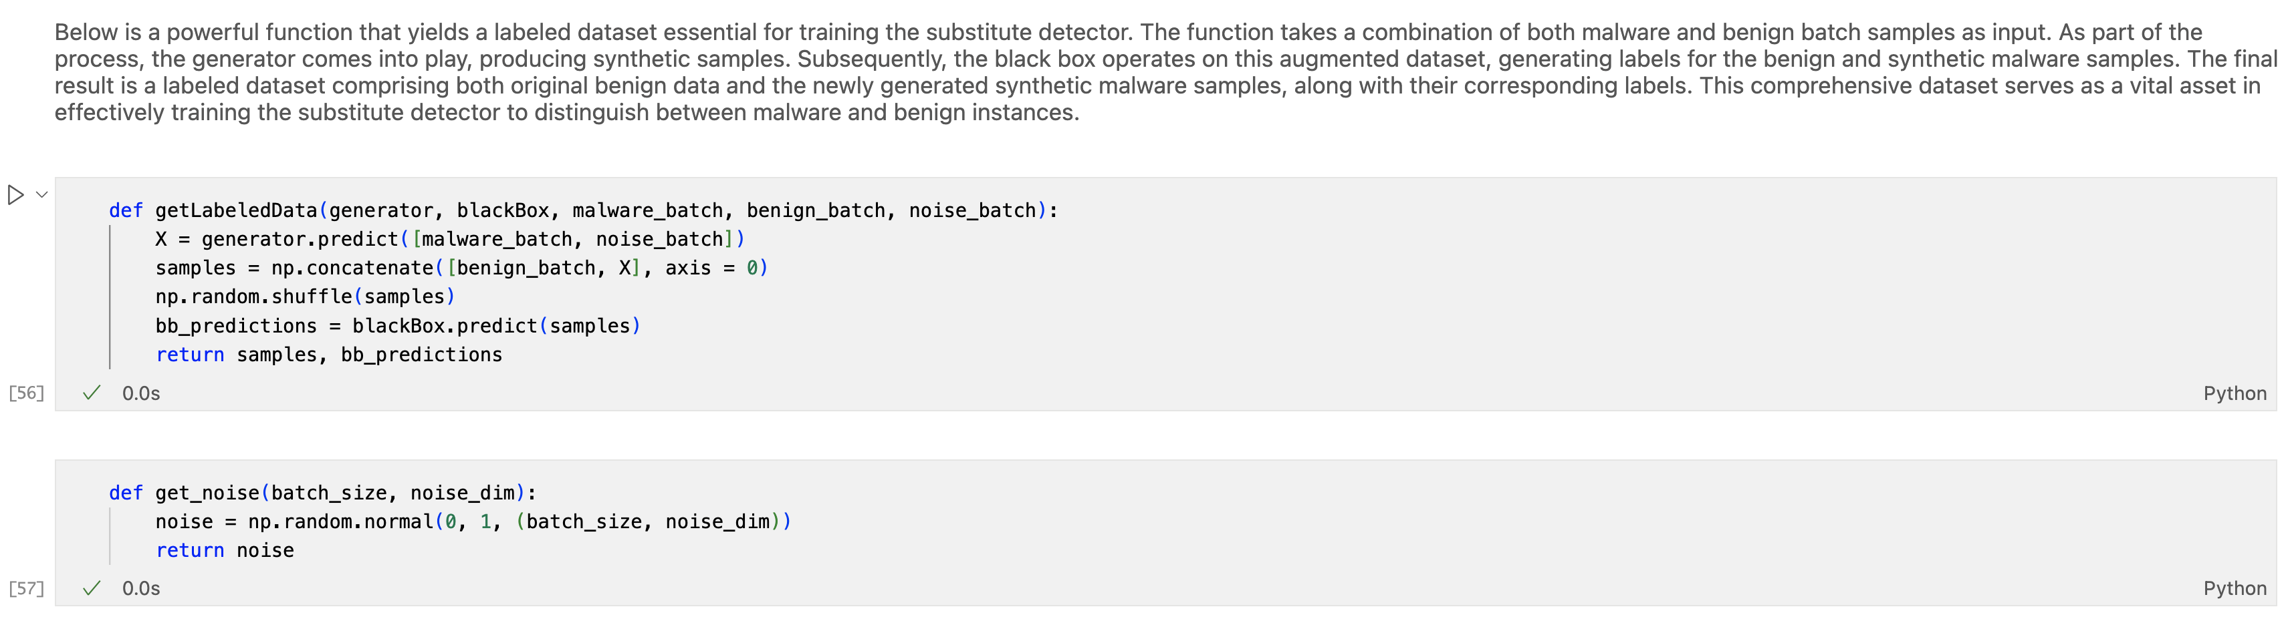
Step - 3: Building and training Mal-GAN

Slide 23
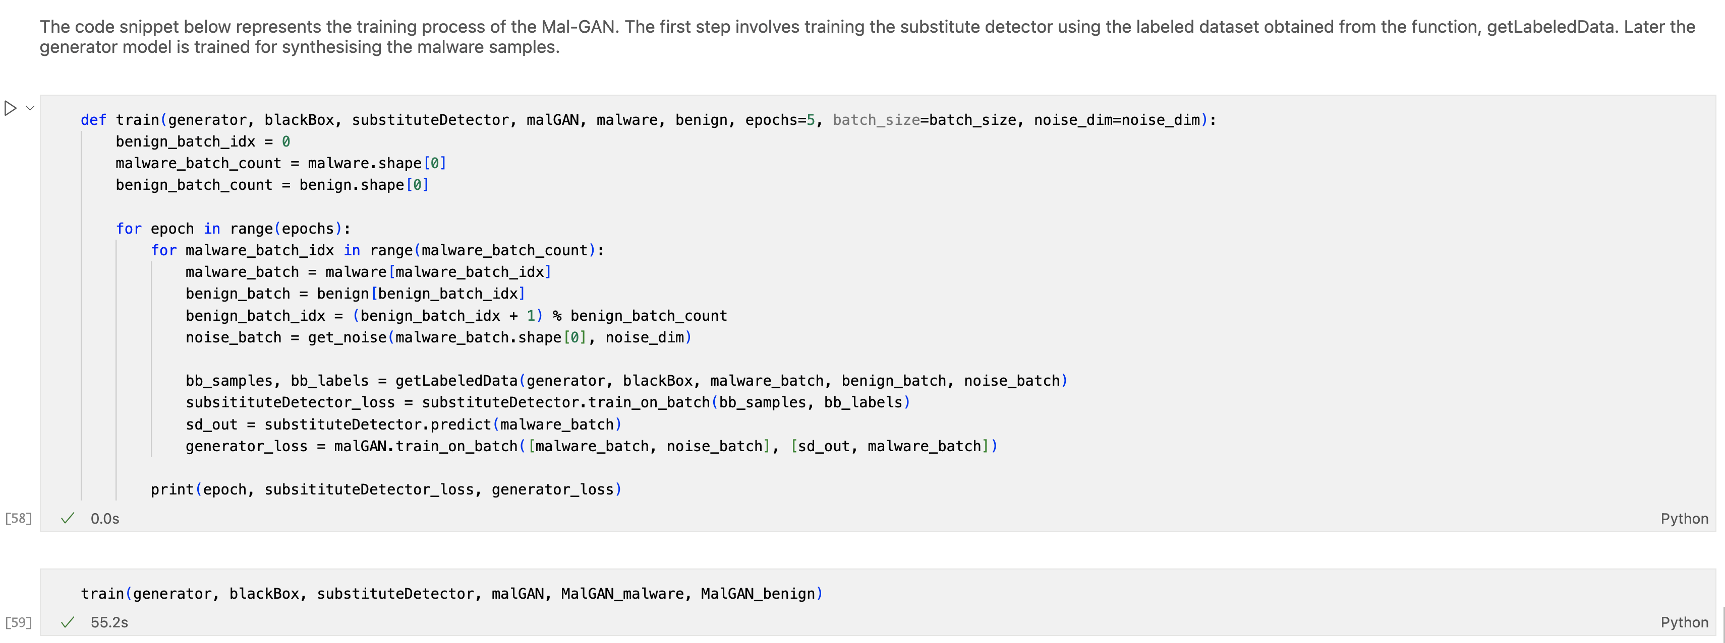
Step - 3: Building and training Mal-GAN

Slide 24
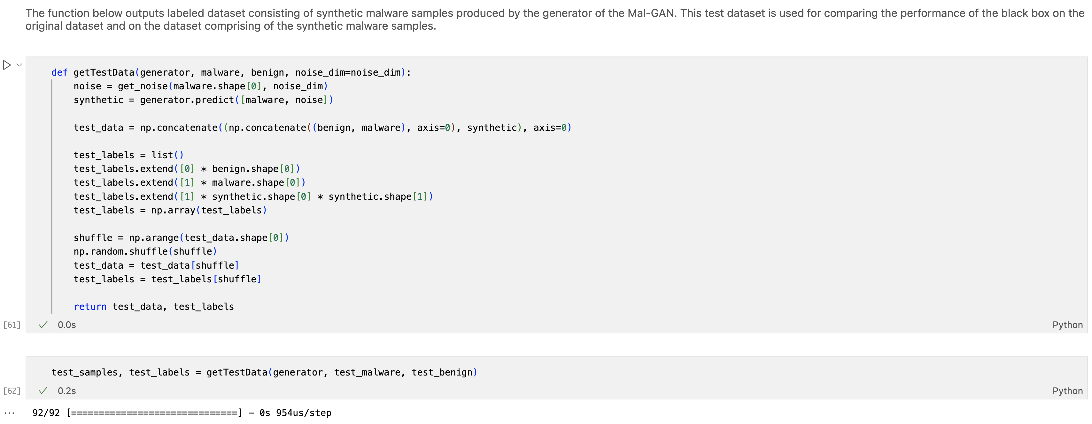
Step - 4 : Testing

Slide 25
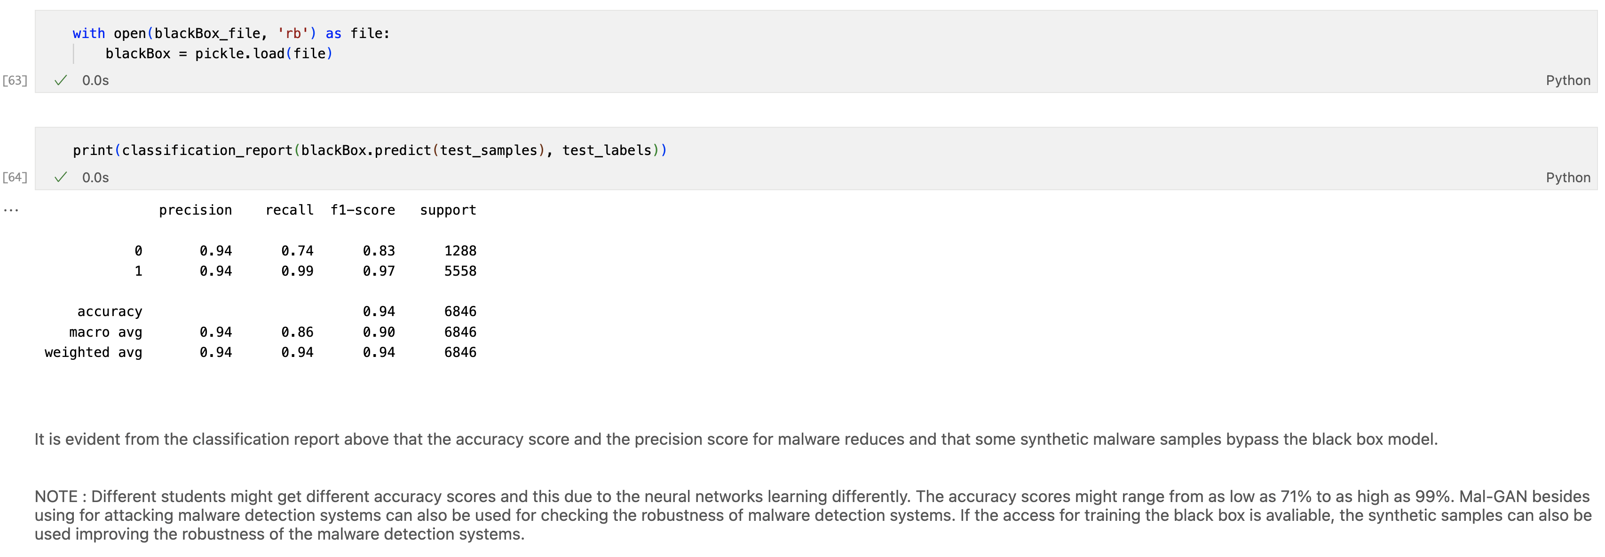
Step - 4 : Testing

